Slide 1


Republic of Sierra Leone Fifth Licensing Round
Presented By: Petroleum Directorate of Sierra Leone

Slide 2
Table of
Contents
1 – About Us
4 – Legal & Regulatory
Framework
2 – Fiscal Framework
5 – Application Procedure
Table of Contents
3 – Technical Summary
6 – Final Remarks

Slide 3
About Us – Who We Are
Frequently Used
Editable Diagram

Slide 4
About Us - Management
Frequently Used
Editable Diagram

Slide 5
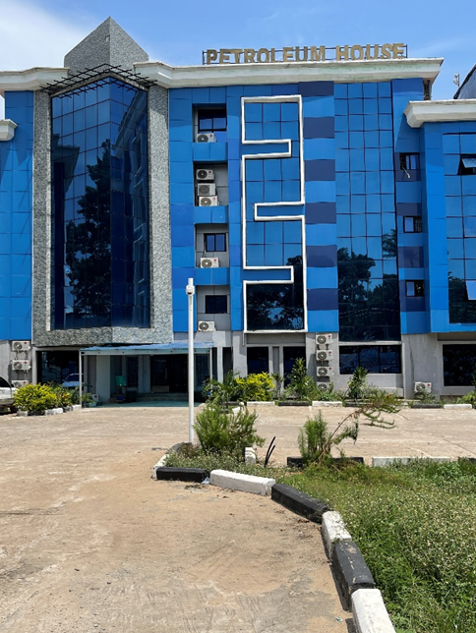
Our Mission:
“To facilitate the optimal exploration, development and production of Sierra Leone’s Potential Petroleum Resources for the long-term benefit of its people, through the development of regulatory guidelines and monitoring contract compliance, having due regard for the economy, the environment, safety, technology, as well as balancing the interests of the nation and investor.”
About Us – Mission & Vision
Our Vision:
“To lead the process of unlocking and realizing The Republic of Sierra Leone’s petroleum resource potential and transform the country’s growth agenda through the sustainable development of the petroleum sector.”

Slide 6
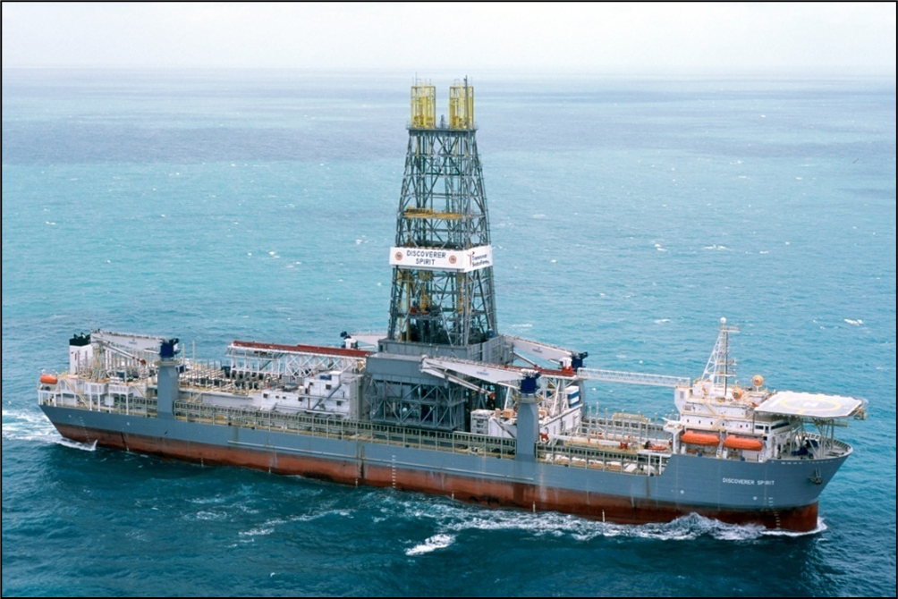



Upstream & Midstream Activities:
Custodian of ALL upstream and midstream Oil & Gas activities for the State.
Perform function of the Ministry, NOC & Regulator.
Petroleum Law:
Create, Review and Amend the Petroleum Exploration and Production Act 2011 (PEPA 2011).
About Us – What We Do
Negotiations:
Negotiate Petroleum Agreements for the State.
Regulate:
Monitor, Regulate and Facilitate upstream activities once International Oil Company (IOC) starts to operate.

Slide 7


Fiscal Framework
Fiscal Framework

Slide 8



Petroleum Agreement Fiscal Framework:
Non-Negotiable Fiscal Elements
Fiscal Framework
1. Royalty (Carried Interest)
2. Corporate Income Tax
3. Petroleum Resource Rent Tax
SL operated a Tax-Royalty Hybrid System.
10% on Gross Production for Crude Oil.
5% Gas.
25% of Gross Profit.
Superficial Tax based on excess profit set by IMF.
Financial modelling shows PRRT is only applicable when the price of oil is $60/bbl and above.

Slide 9
Petroleum Agreement Fiscal Framework:
Negotiable Fiscal Elements
1. Paid Interest | 2. License Fees | 3. Training, R&D Fund | 4. Technology Bonus | 5. Extension Fee
The State maintains the option to negotiate Paid Interest. | Negotiable Set per sq.km | Negotiable Set per graticular block
Fiscal Framework
6. Production Bonus | 7. CSR | 8. Assignment / Farm-out Fees | 9. Signature Bonus | 10. Seismic Data Acquisition
Negotiable When total average daily production reaches a defined threshold for a period of 30 consecutive producing days. | Negotiable Set per graticular block |  |  | Purchase existing or New Acquisition 2D and/or 3D Seismic Data from TGS.

Slide 10

Technical Summary
Technical Framework
Ishmael Momoh
Petroleum Geologist

Slide 11
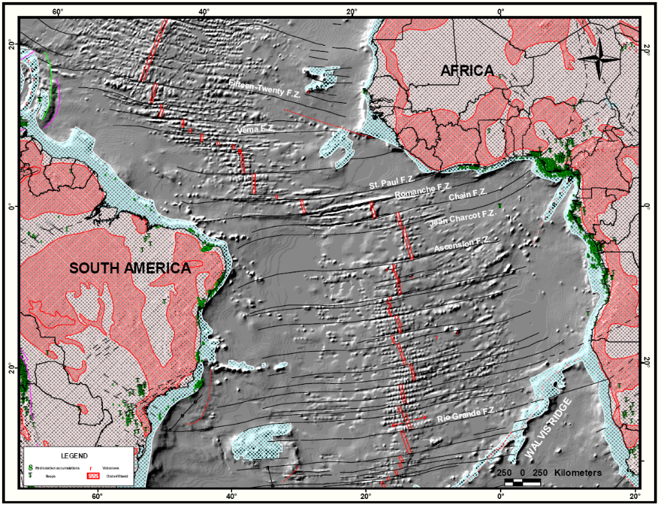
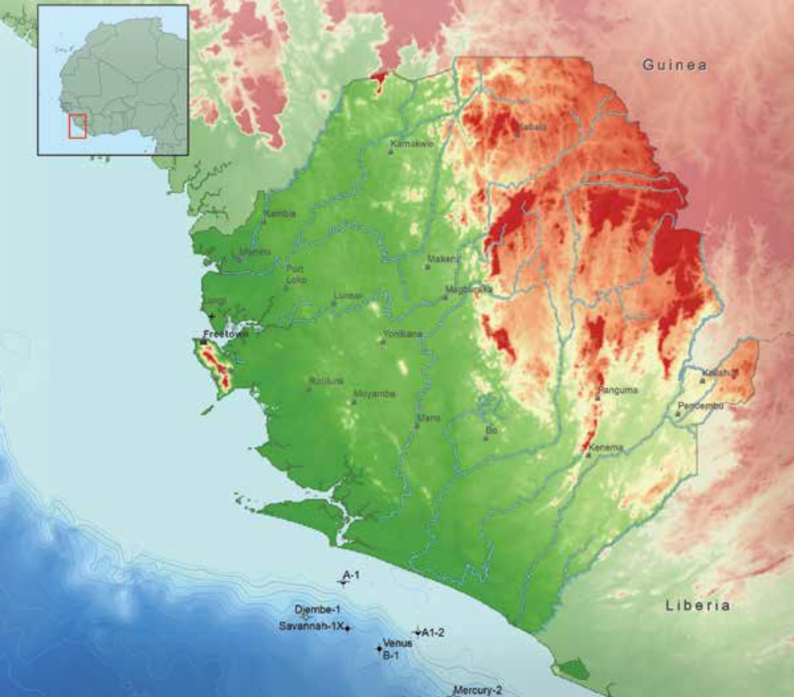
Technical Summary – Regional Setting
Evolution of this area where Sierra Leone is located, relates to the opening of the Atlantic in the Late Jurassic.
Bordered to the North and North-East by Guinea, to the South by Liberia and to the West by the Atlantic ocean.
Sierra Leone forms part of the West African Craton whose counterpart is the Guyana shield.
Seismic data in the Foz do Amazonas and Pará-Maranhão Basins in northern Brazil indicates the potential for the replication of the success on the other side of the Atlantic margin.
Prospects of stratigraphic traps encompassing slope channels and submarine fans of Cretaceous age have been mapped on the Sierra Leone margin.
Technical Summary – Regional Setting
Breakup of Africa and South America and the tectonic evolution of the Equatorial Atlantic [from Brownfield & Charpentier 2006, modified from Mascle et al. 1988]

Slide 12
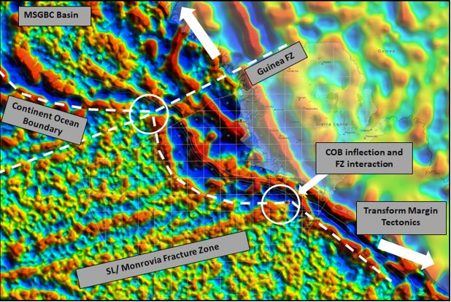
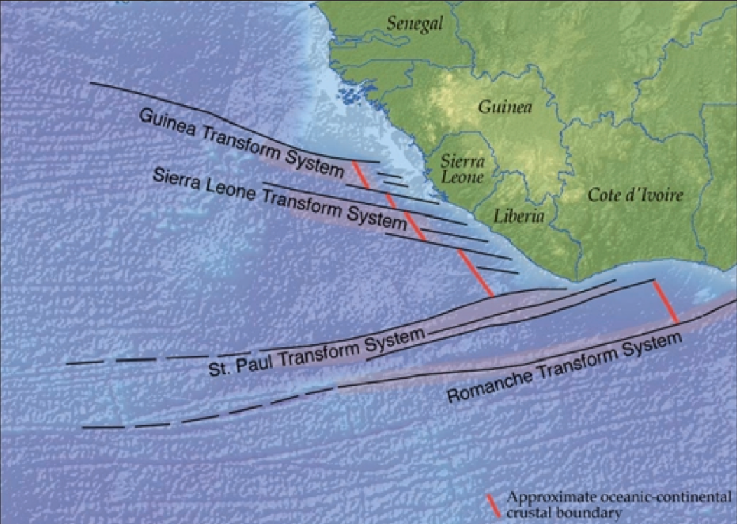
The Sierra Leone Basin
The Basin is a complex area, consisting of continental shelf and slope plateau, steepening down into a deep-water basin.
The Basin has a NW-SE orientation and bounded by two major NW-ESE orientated transform faults.
The Sierra Leone Transform Fault runs in the middle of the basin, giving the basin two distinct physiographic patterns in the north and south.
These structures to a large extent impose significant control on sediment depositional patterns within the basin.
These structures are result of Early Cretaceous low-angle extensional tectonics associated with the opening of the Central Atlantic.
Technical Summary – Regional Setting
Correlation from Atlantic break-up [Sierra Leone and Guyana] showing the positions of the transform fault systems by Getech

Slide 13
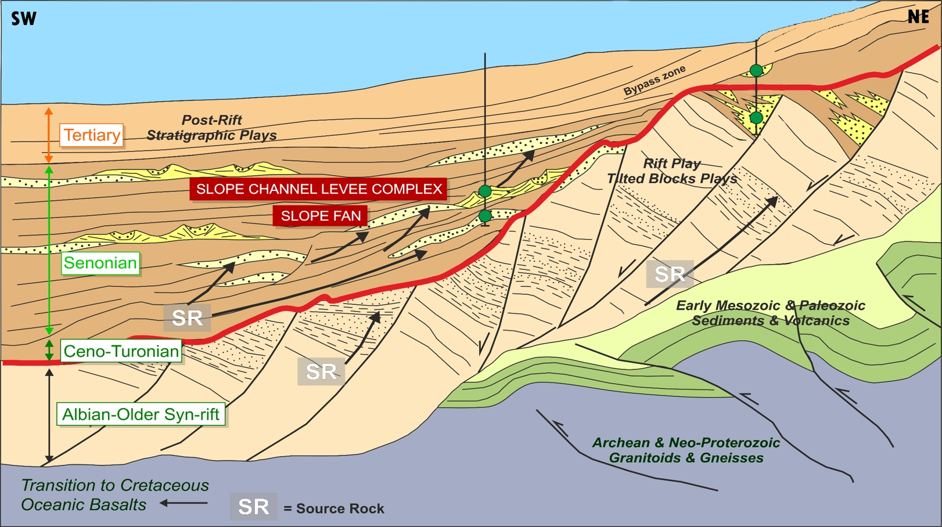
Structural Evolution
3. Post-rift/Post-transform: Passive margin and subsequent uplift in the Paleogene, marked by unconformities.
Technical Summary – Structural Evolution
2. Syn-rift/Syn-transform Phase: Extensional syn-transform faulting throughout the Aptian-Albian. Strike slip structures and inverted fault reactivation are typical.
1. Pre-rift/Pre-transform Phase: Jurassic crustal thinning/mantle with associated plume.

Slide 14
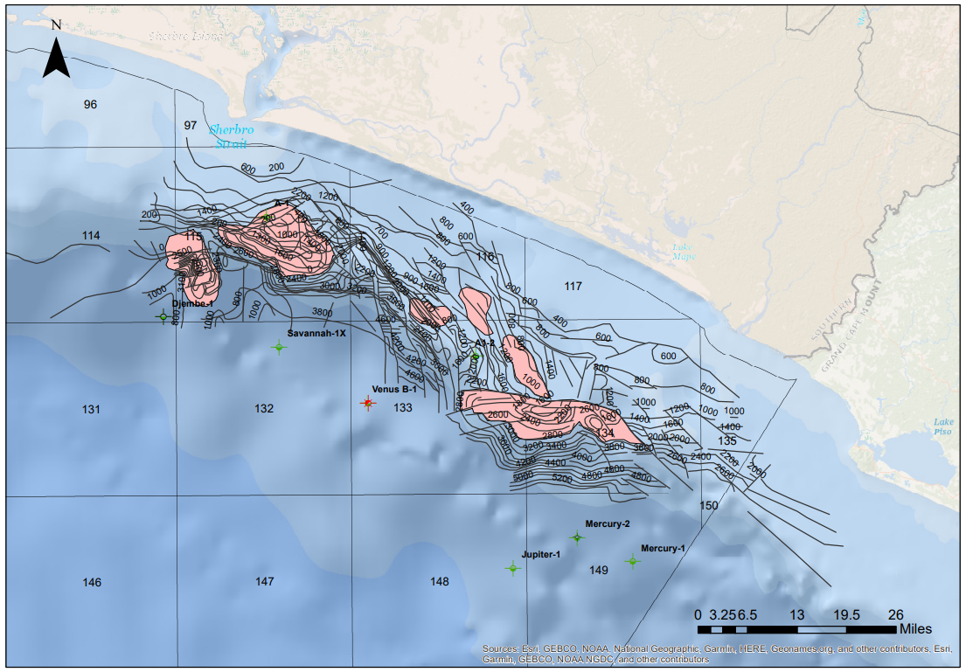
Introduction to Exploration
Exploration History
Exploration began in the early 1980s, with initial work focused on shallow waters with 2D seismic & gravimetric surveys offshore.
Subsequent drilling of A-1 (Mobil) and A1-2 (Amoco) between 1982-85 on the inner shelf (<100m water depth) encountered hydrocarbon shows.
More exploration work followed with the acquisition of speculative 2D data (5,800 line-km) by TGS-NOPEC between 2000-01 sparked another exploration cycle.
From the early 1980’s to present, eight wells have been drilled in the basin.
Technical Summary – Introduction to Exploration
Well locations offshore Sierra Leone
Re-digitized Structure Map from the 80’s

Slide 15
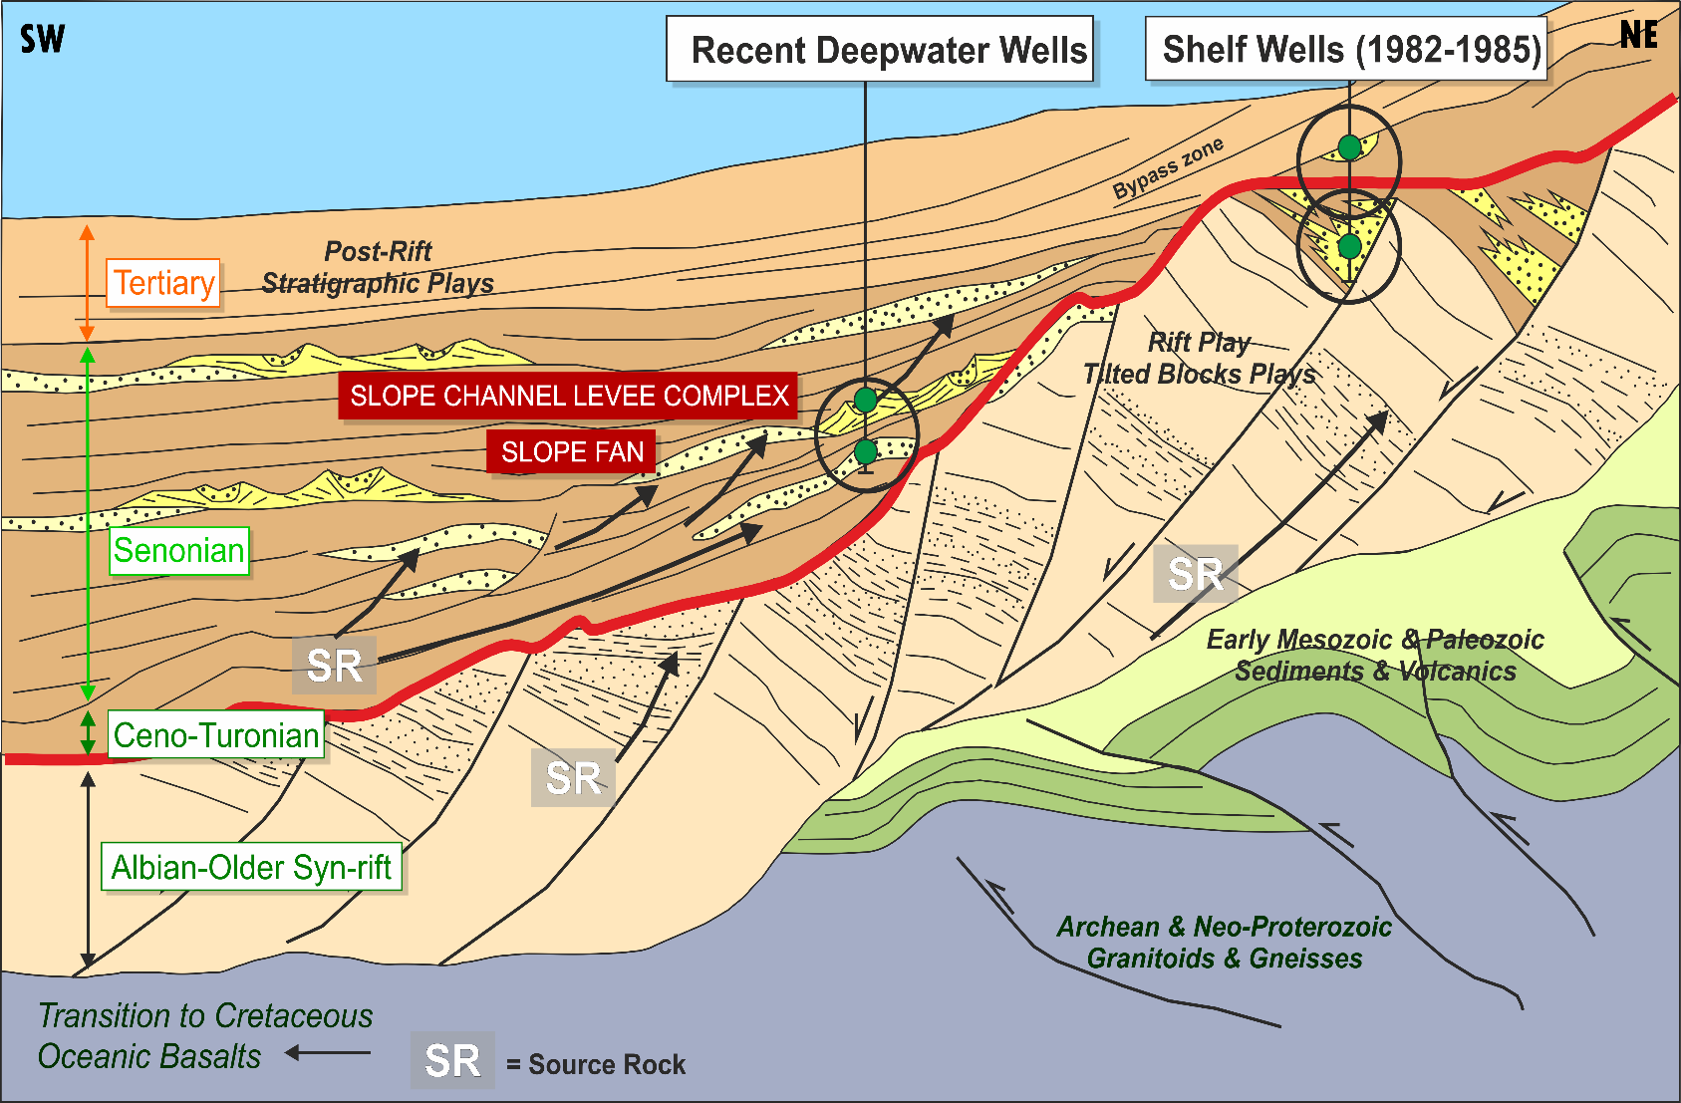
The Petroleum System
Source Rocks (SR)
Aptian - Early Cenomanian [Lacustrine Shales Type – II/III]
Cenomanian – Turonian [Marine Shales – Type-II]
Hydrogen Index (HI)
Sierra Leone: 482-795
Guyana: 450-613
Total Organic Carbon (TOC):
Sierra Leone: 4-20%
Guyana: 4-10% (Liza-1)
The SR have been proven on the conjugate margin.
Reservoirs
Reservoir sequences in the Aptian, Albian, Cenomanian, Maastrichtian and Eocene.
Net sand thickness estimated at 1500m for most sequences.
Average porosity expected to exceed 15% for most sequences.
Technical Summary – Petroleum System
Cartoon section based on a seismic line offshore Sierra Leone showing pre-rift, syn-rift and post-rift sections of the margin [ Anadarko, 2012]
Traps
Structural, stratigraphic and combination traps.
Seals
Lateral Transformational Shales (effective seals), regional hemi-pelagic shales and sealing faults.

Slide 16
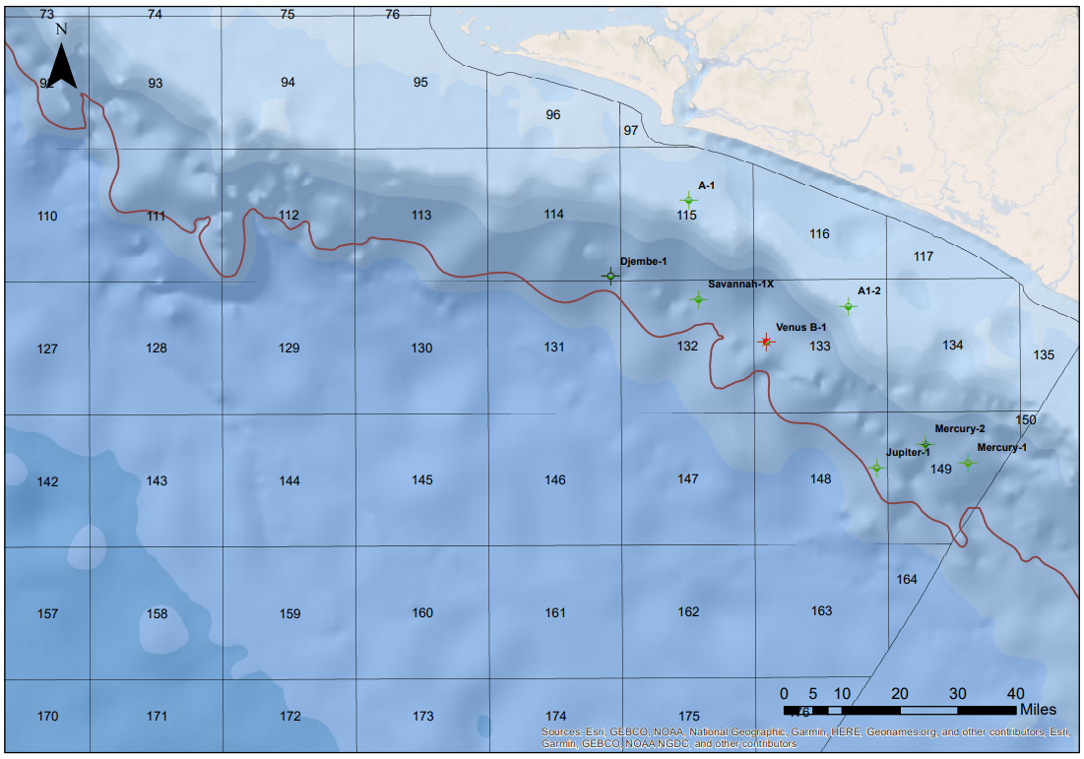
The Discoveries
1. Venus – B1 (2009) – Anadarko
Water Depth: 1,800m, TD: 5,636m in Albian
14m net oil pay (condensate) in Cretaceous age sediments
Several good quality reservoir intervals all the way down to TD.
2. Mercury – 1 (2010) – Anadarko
Water Depth: 1,600m, TD: 4,862m in Albian
41m net oil pay in Cretaceous age fan system.
35m net oil pay in primary objective – light sweet crude (34º– 42º API).
6.4m of 24º API oil in a shallower secondary objective.
Venus-B1
2009
TD – 5639m
14m Turonian pay
Technical Summary – The Discoveries
Mercury-1
2010
TD – 4862m
6m Campanian pay
35m Turonian pay
Well Locations Offshore Sierra Leone

Slide 17
The Discoveries
3. Jupiter-1 (2012) – Anadarko
Water Depth: 2,199m, TD: 6,465m
The well intersected ~ 30m of pay (condensate) in the primary Upper Cretaceous objective and encountered an OWC.
Savannah-1x
2013
TD – 4742m
3m Turonian pay
Technical Summary – The Discoveries
Jupiter-1
2012
TD – 6465m
30m Turonian pay
4. Savannah-1X (2013) - Lukoil
Water Depth: 2,153m, TD: 4,737m
The well intersected ~3m oil pay in the primary objective.
Tested numerous high-quality reservoirs.
Well Locations Offshore Sierra Leone

Slide 18
Wells
Technical Summary - Wells
Total Depth, TD (m)
Water depth (m)
Time (days)
Average Well Depth – 3217m
Average Duration of drilling a Well – 54.3 days
Average Water Depth – 1985m
Average Cost of drilling a Well - $60MM as of 2013

Slide 19
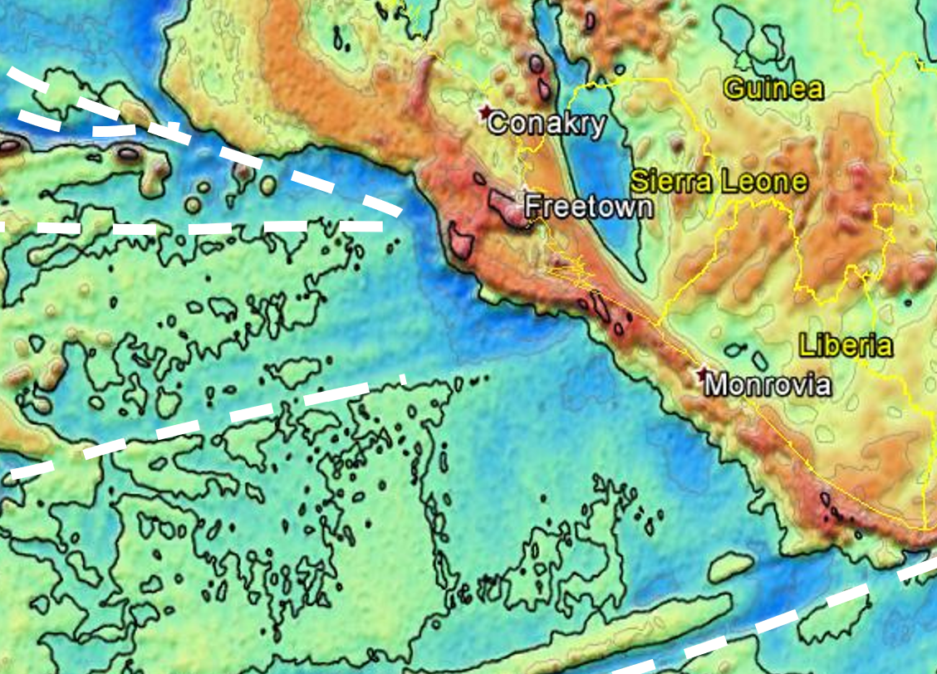
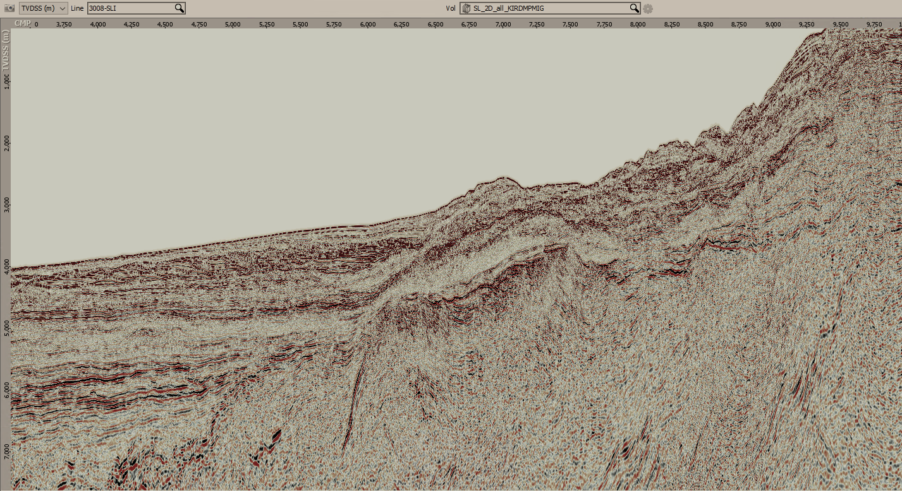
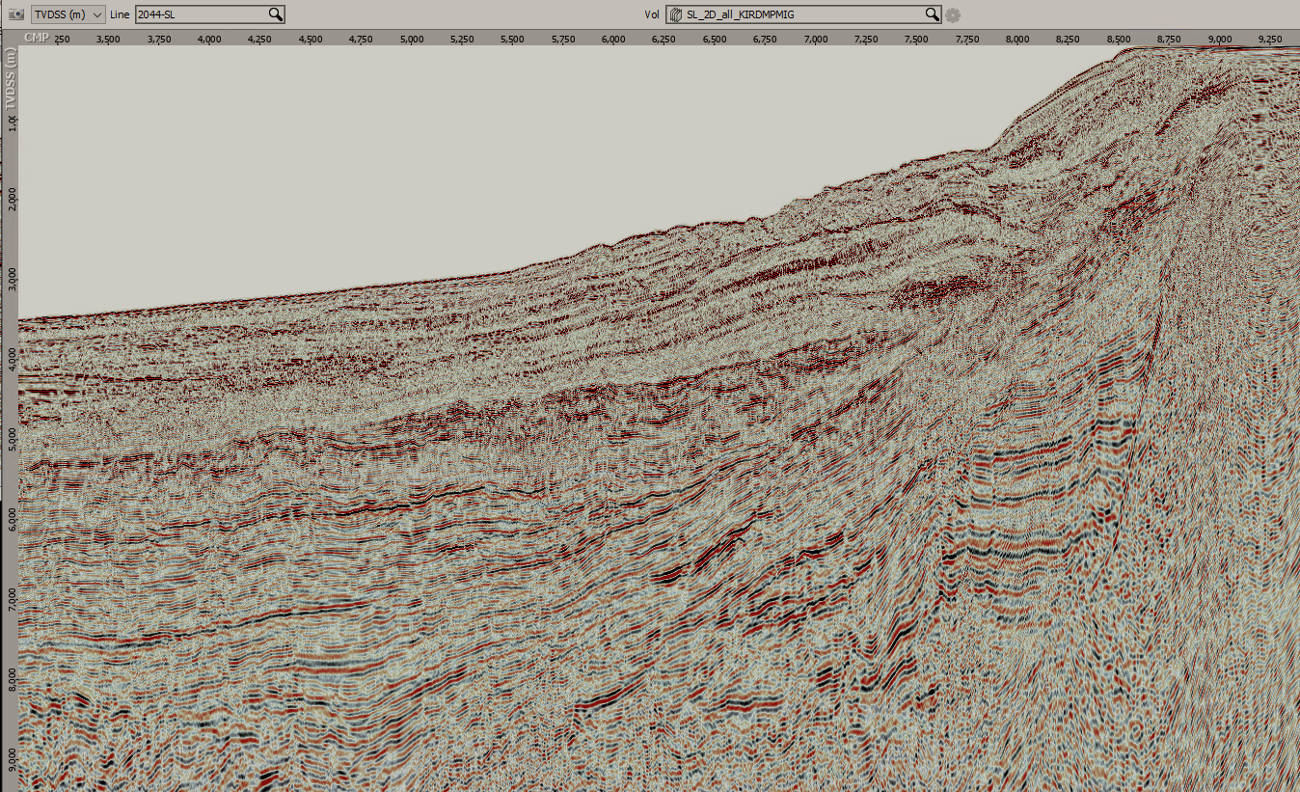
Prospectivity
Oblique margin developments might enhance :
Potential extension of lagoonal and/or lacustrine source rocks into present-day deep-water areas,
Elevation of early heat flow, and
Fracture zone reactivation resulting in rejuvenation of sediment input and hence reservoir deposition.
Technical Summary – Prospectivity
Line 3008-SLI
North of SLTZ
Satellite Free Air Gravity
[Sandwell 2010]
The margin along the Basin changes in orientation from NW-SE to more E-W on either side of the Sierra Leone Transform.
With respect to margin geometry, this means that the Northern area is more likely to be considered an oblique margin, whereas the Southern part of the basin resembles more a passive margin.
Line 2044-SL
South of SLTZ
Seismic 2D Transects [TGS 2013]

Slide 20
Prospectivity (Shallow Water)
Rifted fault blocks in proximal offshore areas.
Targets in water depths of less than 150m .
Targets up-dip of deep-water discoveries [reduced drilling costs].
Technical summary – Prospectivity
Re-digitized 80’s Data with ArcGIS [PDSL, 2022]
Rotated Fault Blocks Brightening into Fault Seal

Slide 21
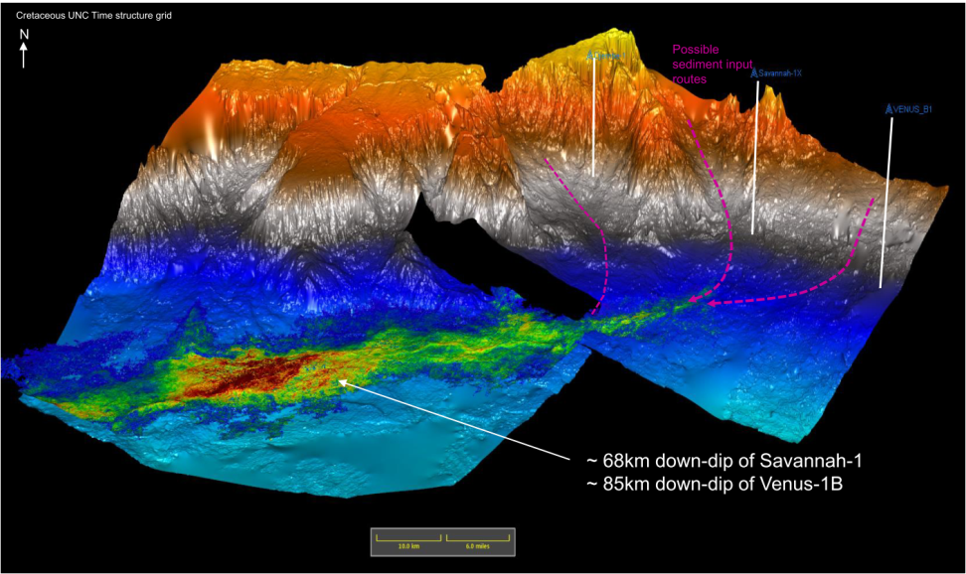
Prospectivity (Deep-water)
Numerous untested deep-water turbidite and basin floor fan plays.
Low-angle down dip fans have potential to set up areally large traps.
Excellent quality reservoirs in Santonian and Campanian sediments.
Down dip reservoir quality predicted to significantly improve.
Technical summary – Prospectivity
The current understanding is that submarine fan development in the basin was mainly concentrated over the
Late Albian Unconformity (MCU),
Santonian Unconformity, and
Base Tertiary Unconformity (K/T Boundary)
Geo-body Mapping from the Vega & Leo Pospects [Africa Petroleum; 2017]

Slide 22
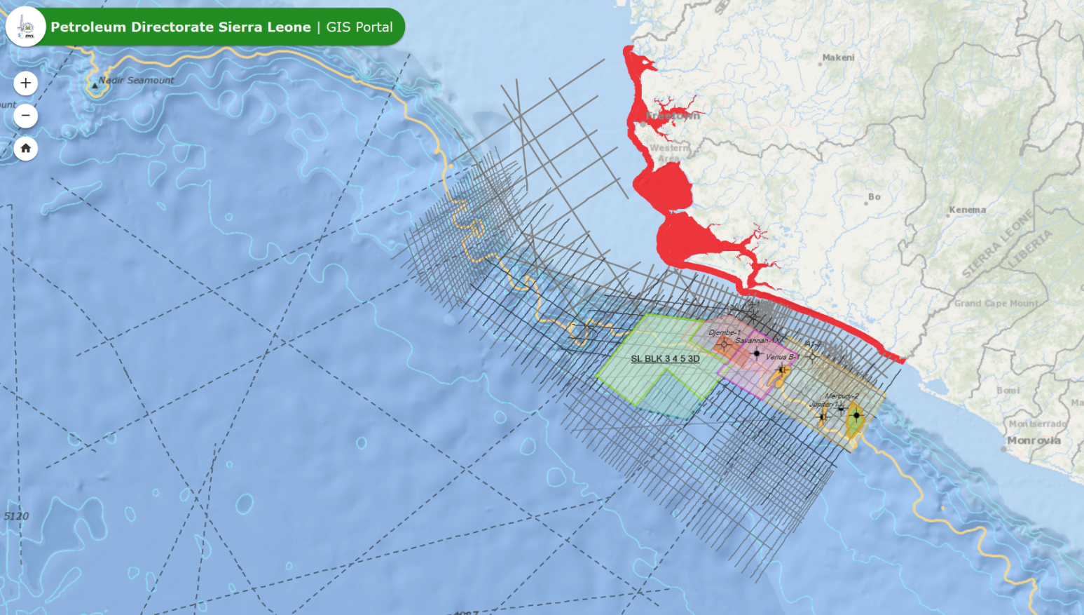
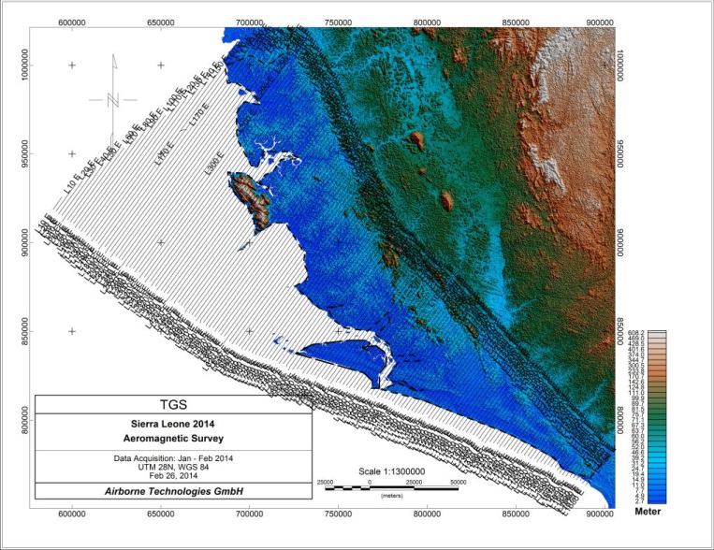
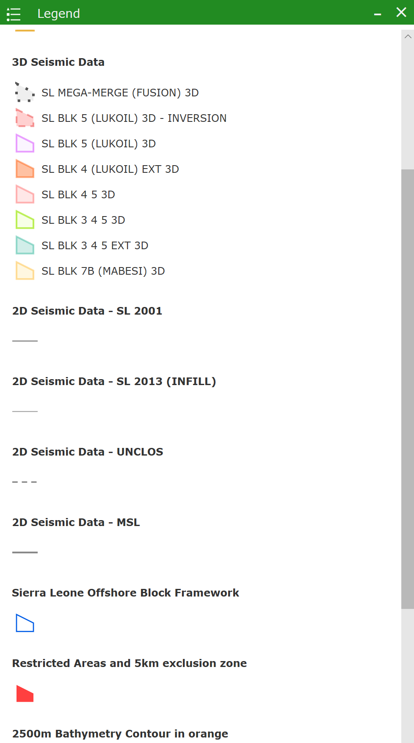
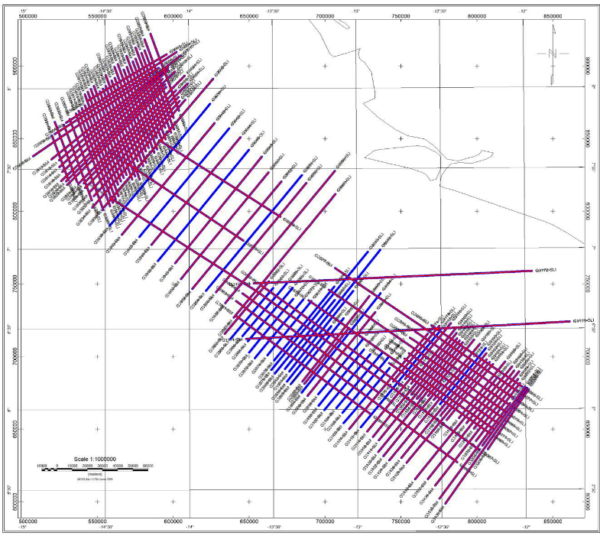
Data Coverage – 2D and 3D Seismic
Technical Summary – Data Coverage
Aeromagnetics
Marine Gravity & Magnetics

Slide 23
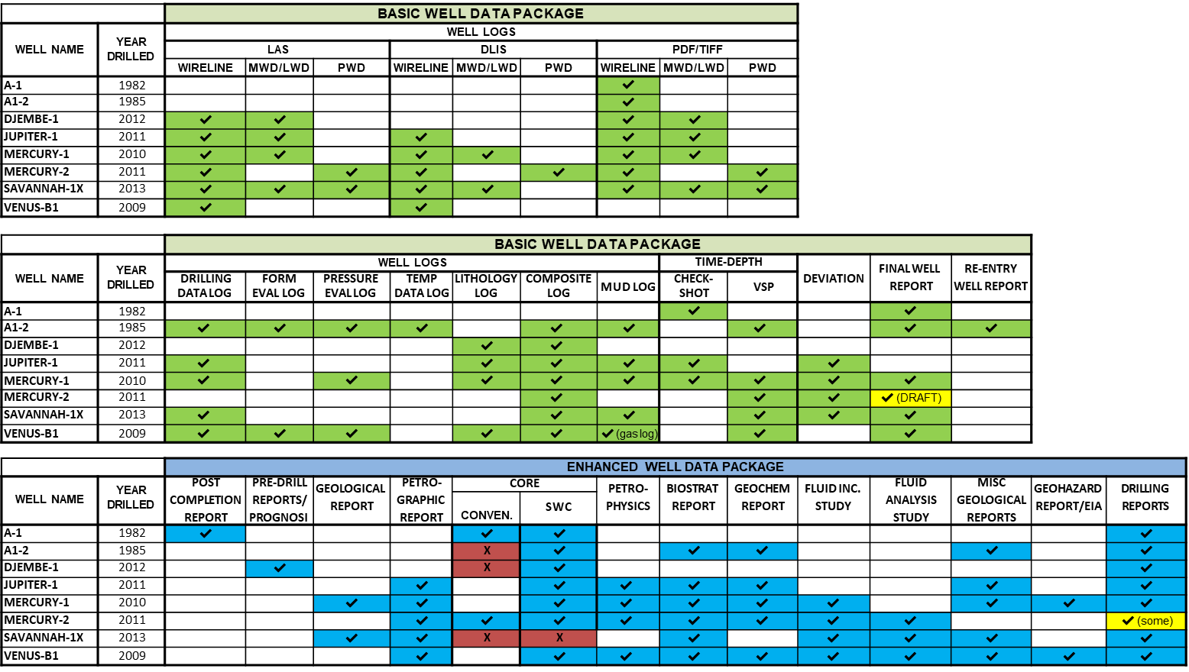
Data Coverage – Well Data Packages
Technical Summary – Data Coverage

Slide 24
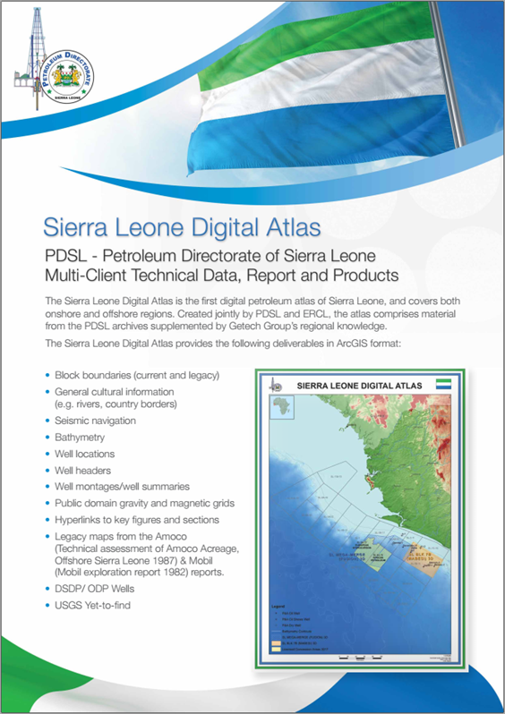
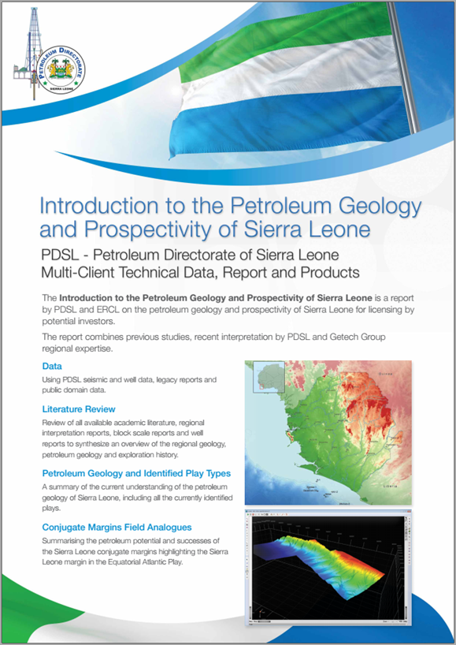
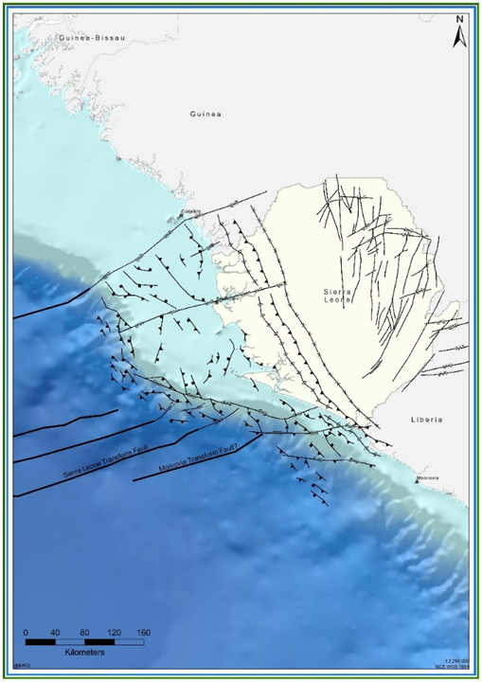
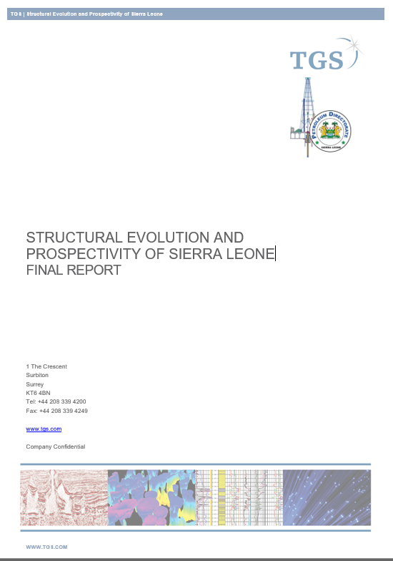
Interpretation Data Packages
Technical Summary – Data Coverage
Petroleum Geology & Prospectivity
Petroleum Digital Atlas
Structural Studies
Structural Evolution & Prospectivity Report

Slide 25
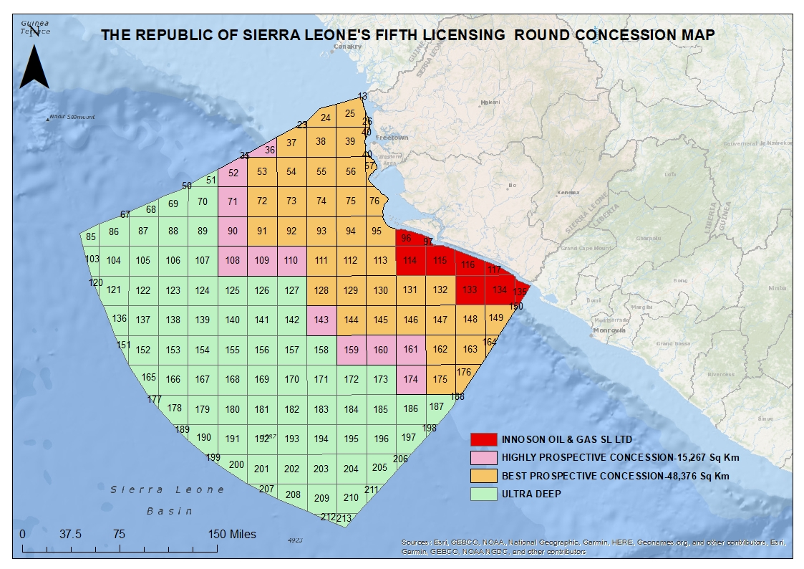
Concession Areas on Offer
Offshore covers approximately 170,000 km², with 140,000 km² of offshore open acreage available.
63,643 km² of acreage open for the Fifth Licensing Round.
After a block re-demarcation in 2018, the PDSL now has a series of smaller blocks that align with the ECOWAS north-south grid system.
Each block is approximately 1360 km² .
Minimum of Three (3) Graticular Blocks constitute a Contract Area.
Technical Summary – Concession Area

Slide 26
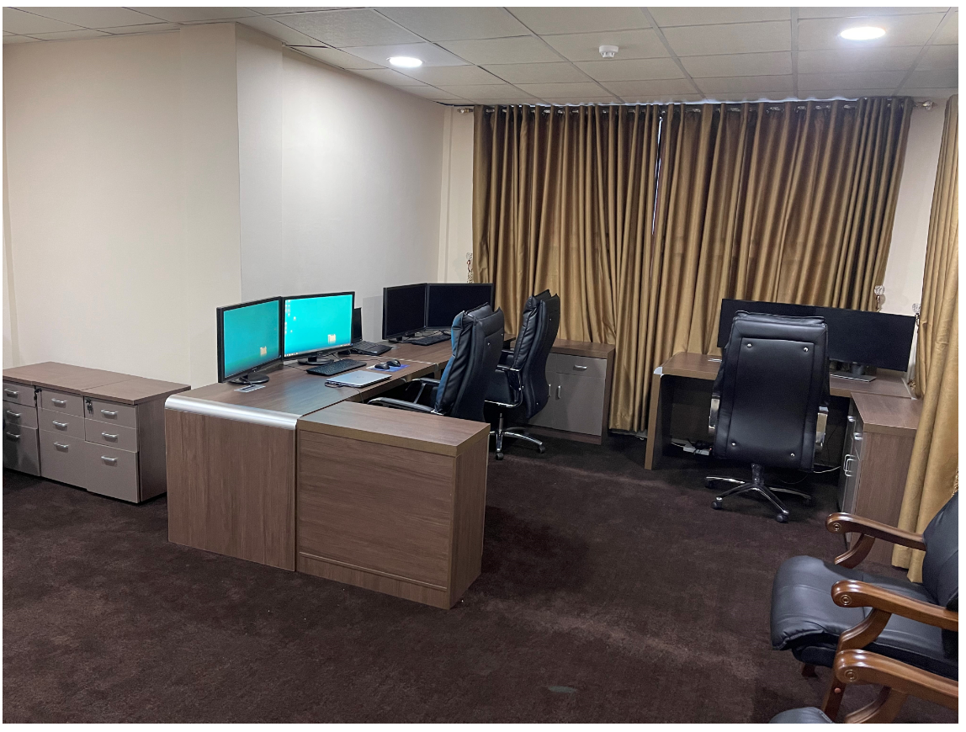
Data Rooms
The technical data available to view in the data room includes:
Technical Presentations
Technical Reports
29,000-line km of 2D seismic
11,000 km² of 3D seismic
Well reports.
Technical Summary – Data Rooms

Slide 27


Data Purchase
Technical Data is available to purchase from the Petroleum Directorate’s data brokerage partner TGS.
Further information is available on the Petroleum Directorate’s websites at: www.pd.gov.sl
Technical Summary – Data Purchase

Slide 28


Legal & Regulatory Framework
Legal & Regulatory Framework
Michaela B.E. Swallow
Senior Legal Counsel

Slide 29



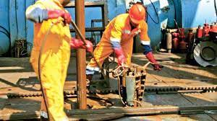
Petroleum Exploration & Production Act 2011
Environmental Protection Agency Act 2008
The contractual relationship between Investor and State is governed by PEPA 2011.
Provides the Administration, Regulation and Management framework of the upstream and midstream petroleum sector and covers:
Legal & Regulatory Framework
Income Tax Act 2000
Resource Ownership and legal & regulatory framework
Fiscal Regime
Good Governance, Transparency and Accountability
HSE and Social Impact
Exploration and Production Periods
Work Program and Operations
Local Content, Economic Development and Technology Transfer
State Participation
Transportation of Oil & Gas
Finance Act 2020
Local Content Act 2016

Slide 30

Types of Petroleum Rights:
Three Types of Petroleum Rights
2. Petroleum License
Legal & Regulatory Framework
Pre-qualification Fees
Application Fees
Minimum Work Program
1. Reconnaissance Permit
3. Permit for Laying and Operation of Pipeline
Pre-qualification
Payment of Application Fee
Reconnaissance Work Program
Payment of minimum annual license fee
Payment of minimum annual training funds
For a period not exceeding two (2) years
Non-Exclusive
A permit for the laying and operation of pipelines to transport petroleum produced from fields.

Slide 31
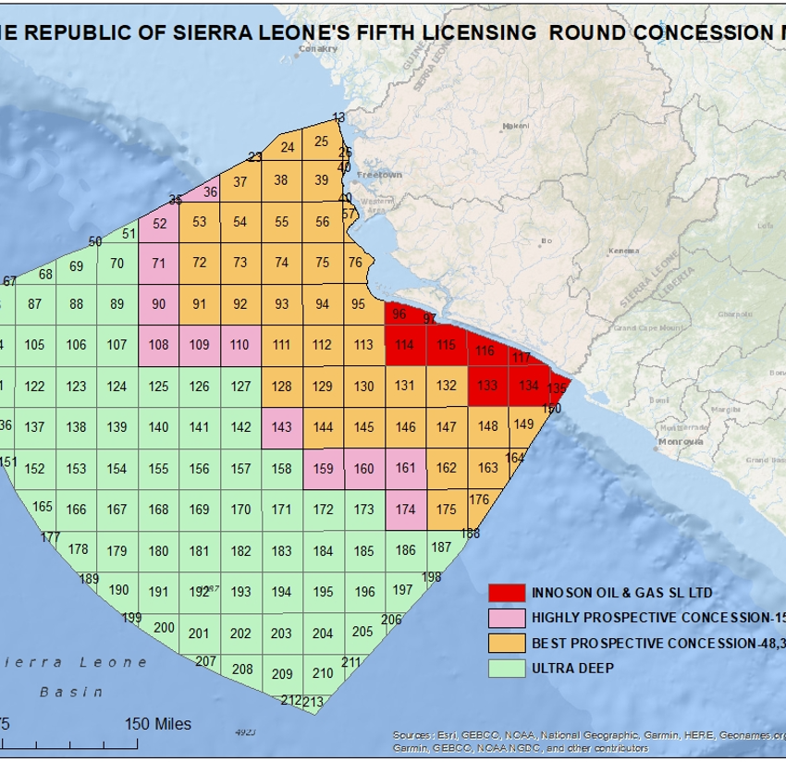



Petroleum License:
Acquisition of Petroleum License
Legal & Regulatory Framework
Licensing Rounds
Pre-Qualification
License Validity
Relinquishment
A Petroleum License can be acquired under a Call for Tender.
Only pre-qualified companies may submit a bid as an operator or petroleum rights holder.
License valid for 30yrs maximum
Exploration Period for 7yrs
Initial – 3yrs
1st Extension – 2yrs
2nd Extension – 2yrs
Development & Production for 23yrs
50% at end of Initial Exploration period
25% at end of 1st Extension Period
25% at end of 2nd Extension Period

Slide 32

Application Procedure
Application Procedure

Slide 33
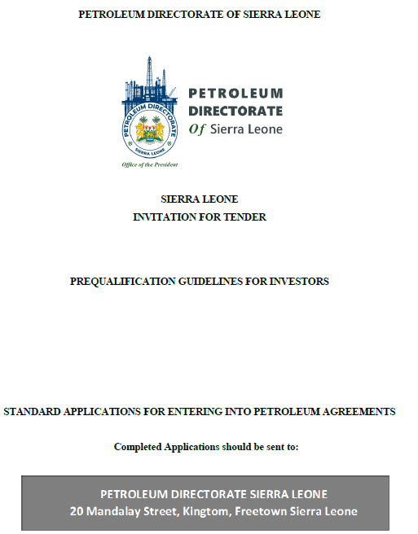
Pre-qualification Process
The Petroleum Exploration and Production Act (PEPA) 2011 requires pre-qualification of applicants for Petroleum Rights.
Application Fee for Pre-qualification is US$15,000
Petroleum Directorate will evaluate the application and then issue a “Notice of Qualification” for the Fifth Licensing Round within 10 Business days.
Application Procedure
Pre-qualification Criteria:
Financial Strength
Operational / Technical Pre-qualification
QHSE Policy Statement
Data Room Visit and Purchase of Seismic Data
Applicant MUST clearly state their wish to apply as:
Operator or
Petroleum Right Holder (Partner / Non-Operator)
www.pd.gov.sl/application

Slide 34
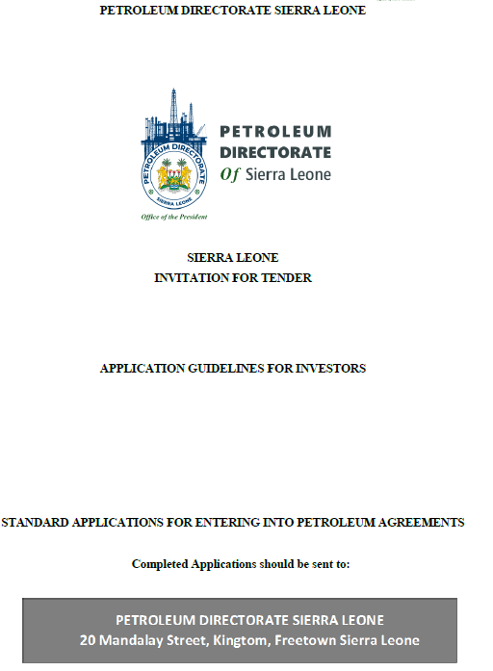
Application Process for Petroleum Rights
See Application Guidelines for Investors.
You must have Pre-qualified (Note that ONLY Operators can submit a bid).
Download Application Templates and Complete:
Section A – Applicant Detail & Financial Information
Section B – Technical Application Summary
Section C – Commercial Proposal
Section D – HSE Summary
Negotiations Term sheet
Pay Application Fee US$30,000 per Contract Area (3 Graticular Blocks). (Note that a fee of US$5,000 applies for any additional graticular block above the minimum Contract Area).
Submit Application Online / In-Person.
Application Procedure
www.pd.gov.sl/application

Slide 35
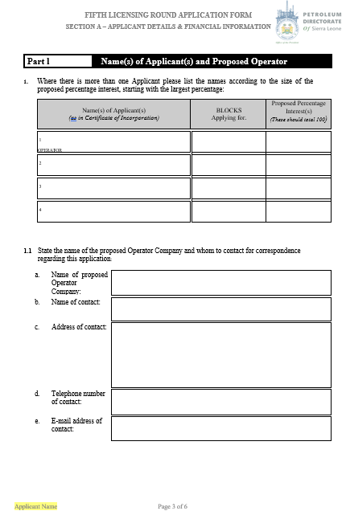
Application Forms:
Section A – Applicant(s) Details and Financial Information
Part I – Name(s) of Applicant(s)
List Details of Applicants (Operator and any Partners.
Part II – Contract Area Applied For
Detail Contract Area applied for
Application Procedure
Part III – Pre-qualification Information
It should include a copy of each of the Applicant(s) (Operator and any Partners) Pre-qualification Application.
Additional Information
A brief description of technical and industrial information available to the Applicant.
Particulars of Financial Resources:
Capital
Credit Facilities
Guarantees (Parent Company)

Slide 36
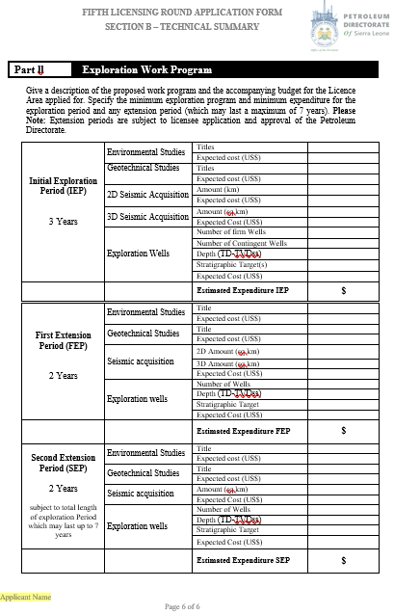
Application Forms:
Section B – Technical Proposal Summary
Part I – Technical Assessment
Demonstrate Applicant’s current assessment of the resource potential.
Part II – Exploration Work Program
Demonstrates Applicants future plans to undertake exploration work program and evaluate the acreage.
Application Procedure
Note:
Section B forms a crucial part of the application and evaluation criteria

Slide 37
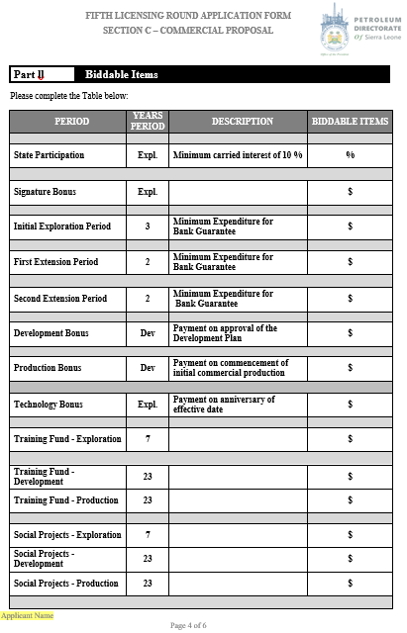
Application Forms:
Section C – Commercial Proposal
Part I – Fees
Pre-qualification payment confirmation.
Licensing Round Application payment confirmation.
Part II – Biddable Items
Application Procedure
Minimum expenditure for each period.
Part III – Additional Aspects
Applicant provides details of:
Training and Development
Social Projects
Any other info that adds value to application.

Slide 38
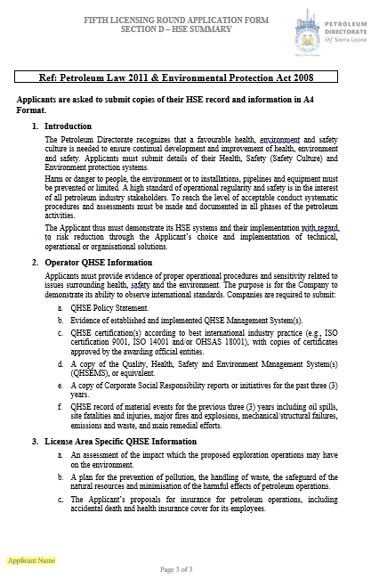
Application Forms:
Section D – Health, Safety & Environment Summary
Provide QHSE Policy
Evidence of established and implemented QHSE Management System
QHSE Certificates (ISO 9001, ISO 14001 etc.)
A copy of CSR Reports
QHSE record for past 3 years
Plan for prevention of pollution
Plan for handling of waste
Application Procedure

Slide 39
Bid Evaluation
In awarding a Petroleum License, the Petroleum Directorate must be satisfied that the Applicant has developed an exploration strategy and work program that will advance the assessment and understanding of the petroleum potential of the permit area.
The strategy must be underpinned by a sound technical assessment of the Contract Area, along with evidence of the technical, financial and other capabilities necessary to facilitate the smooth implementation of the work program.
Application Procedure
Consideration may also be given to any past performance issues, either within the jurisdiction of Sierra Leone or internationally, that may impact on the ability of the Applicant to undertake the proposed work program.

Slide 40


Final Remarks
Foday B.L. Mansaray II
Final Remarks
Director General

Slide 41
Final Remarks
There are many opportunities to develop new and exciting prospects within the northern area of the Sierra Leone basin that differ from the proven system in the south.
Considering also the potential waiting down-dip, Sierra Leone has all the subsurface requirements to be the next big African exploration hotspot - especially when the new stable and transparent above ground investment environment is fully factored in.
Access to acreage
Good fiscal conditions
Transparent and stable government
A positive investment environment
Good quality data with reprocessing and new data on the agenda, plus
The world-leading conjugate discoveries
All indicate that Sierra Leone will soon join the exclusive club of African oil-producing nations.
‘Unity, Freedom and Justice’ is emblazoned on the country’s coat of arms, but these three words also spell a great investment opportunity to those that look into the subsurface.
Final Remarks

Slide 42




In Conclusion:
Petroleum Directorate of Sierra Leone
TRANSPARENT LICENSING ROUND AND REGULATOR
Final Remarks
Politically Stable
Proven Petroleum System
Data Coverage
Terms
Peaceful Regime Change 3times in 20 years
Proven working petroleum system with 4 discoveries made
Excellent Geological and Geophysical Data Coverage
Favorable and Competitive Regulatory, Legal and Fiscal terms

Slide 43




SPONSORS & PARTNERS
Applications must be received by the Petroleum Directorate Online or in Freetown by:
12 Noon Wednesday 30th September 2022
Contact Us
Office Hours
Our Address
Monday – Saturday
07:00 – 17:00
20 Mandalay Street,
Kingtom, Freetown
Sierra Leone
Get In Touch
Website
+232 (0) 74 33 65 10
+44 (0) 7534 024 665
info@pd.gov.sl
www.pd.gov.sl

